Slide 1
PTRA Institute/Workshop
Participant Documentation

Slide 2
Social Media
We appreciate your help in spreading news about your workshop experience through social media. Please visit our website
(https://aaptptra.com/ ) for links or use the following:
Social Media #ptraphysics #aaptptra #ptra20
Twitter: @aapt_ptra
Instagram: aapt_ptra
Facebook: AAPT/PTRA

Slide 3
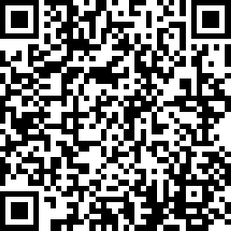
Attendance
Please go to the link below to register your attendance at this workshop. This allows us to keep track of contact hours and helps justify funding.
https://www.surveymonkey.com/r/Pre20
Notes:
Allows KJM to have list of who can be added to Facebook page

Slide 4
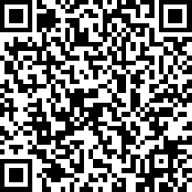
Workshop Evaluation
Please use the link or QR code to give us feedback regarding the workshop you just attended. This information will be used to plan/revise future professional development so we appreciate your honesty and time to complete the survey.
https://www.surveymonkey.com/r/post20
Notes:
PTRA general Survey

Slide 5
Thank You For Coming
Regularly visit our website
(https://aaptptra.com/ ) for more workshops or contact us
karen@aaptptra.com

